Slide 1
Steps of the Scientific Method

Slide 2
The Scientific Method involves a series of steps that are used to investigate a natural occurrence.

Slide 3
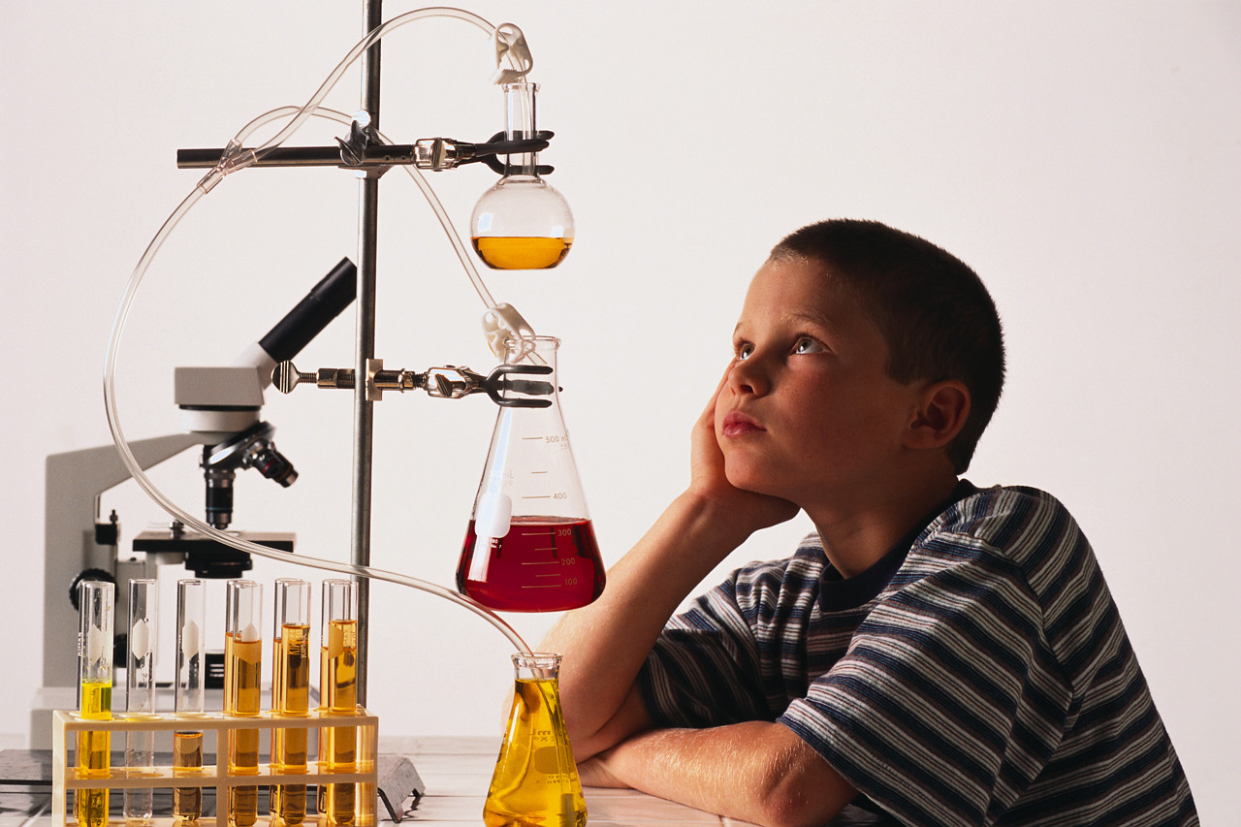
We shall take a closer look at these steps and the terminology you will need to understand before you start a science project.

Slide 4
Scientific Method
Problem/Question
Observation/Research
Formulate a Hypothesis
Experiment
Collect and Analyze Results
Conclusion
Communicate the Results

Slide 5
Steps of the Scientific Method
1. Problem/Question: Develop a question or problem that can be solved through experimentation.

Slide 6
Steps of the Scientific Method
2. Observation/Research: Make observations and research your topic of interest.

Slide 7
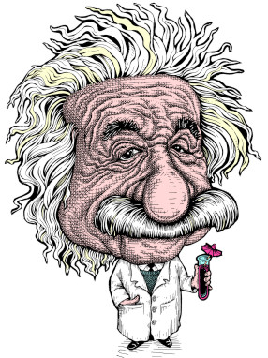
Do you remember the next step?

Slide 8
Steps of the Scientific Method
3. Formulate a Hypothesis: Predict a possible answer to the problem or question.
Example: If soil temperatures rise, then plant growth will increase.

Slide 9
Steps of the Scientific Method
4. Experiment: Develop and follow a procedure.
Include a detailed materials list.
The outcome must be measurable (quantifiable).

Slide 10
Steps of the Scientific Method
5. Collect and Analyze Results: Modify the procedure if needed.
Confirm the results by retesting.
Include tables, graphs, and photographs.

Slide 11
Steps of the Scientific Method
6. Conclusion: Include a statement that accepts or rejects the hypothesis.
Make recommendations for further study and possible improvements to the procedure.

Slide 12
Steps of the Scientific Method
7. Communicate the Results: Be prepared to present the project to an audience.
Expect questions from the audience.

Slide 13
Think you can name all seven steps?
Collect and Analyze Results
Formulate a Hypothesis
Communicate the Results
Observation/Research
Problem/Question
Experiment
Conclusion

Slide 14
Let’s put our knowledge of the Scientific Method to a realistic example that includes some of the terms you’ll be needing to use and understand.

Slide 15
Problem/Question
John watches his grandmother bake bread. He ask his grandmother what makes the bread rise.
She explains that yeast releases a gas as it feeds on sugar.

Slide 16
Problem/Question
John wonders if the amount of sugar used in the recipe will affect the size of the bread loaf?

Slide 17
Caution!
Be careful how you use effect and affect.
Effect is usually a noun and affect, a verb.
“ The effect of sugar amounts on the rising of bread.”
“How does sugar affect the rising of bread?”

Slide 18
Observation/Research
John researches the areas of baking and fermentation and tries to come up with a way to test his question.
He keeps all of his information on this topic in a journal.

Slide 19
John talks with his teacher and she gives him a Experimental Design Diagram to help him set up his investigation.

Slide 20
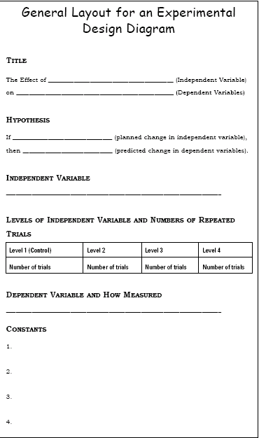

Slide 21
Formulate a Hypothesis
After talking with his teacher and conducting further research, he comes up with a hypothesis.
“If more sugar is added, then the bread will rise higher.”

Slide 22
Hypothesis
The hypothesis is an educated guess about the relationship between the independent and dependent variables.
Note: These variables will be defined in the next few slides.

Slide 23
Do you know the difference between the independent and dependent variables?

Slide 24
Independent Variable
The independent, or manipulated variable, is a factor that’s intentionally varied by the experimenter.
John is going to use 25g., 50g., 100g., 250g., 500g. of sugar in his experiment.

Slide 25
Dependent Variable
The dependent, or responding variable, is the factor that may change as a result of changes made in the independent variable.
In this case, it would be the size of the loaf of bread.

Slide 26
Experiment
His teacher helps him come up with a procedure and list of needed materials.
She discusses with John how to determine the control group.

Slide 27
Control Group
In a scientific experiment, the control is the group that serves as the standard of comparison.
The control group may be a “no treatment" or an “experimenter selected” group.

Slide 28
Control Group
The control group is exposed to the same conditions as the experimental group, except for the variable being tested.
All experiments should have a control group.

Slide 29
Control Group
Because his grandmother always used 50g. of sugar in her recipe, John is going to use that amount in his control group.

Slide 30
Constants
John’s teacher reminds him to keep all other factors the same so that any observed changes in the bread can be attributed to the variation in the amount of sugar.

Slide 31
Constants
The constants in an experiment are all the factors that the experimenter attempts to keep the same.

Slide 32
Can you think of some constants for this experiment?

Slide 33
Constants
They might include:
Other ingredients to the bread recipe, oven used, rise time, brand of ingredients, cooking time, type of pan used, air temperature and humidity where the bread was rising, oven temperature, age of the yeast…

Slide 34
Experiment
John writes out his procedure for his experiment along with a materials list in his journal. He has both of these checked by his teacher where she checks for any safety concerns.

Slide 35
Trials
Trials refer to replicate groups that are exposed to the same conditions in an experiment.
John is going to test each sugar variable 3 times.

Slide 36
Collect and Analyze Results
John comes up with a table he can use to record his data.
John gets all his materials together and carries out his experiment.

Slide 37
Size of Baked Bread (LxWxH) cm³
Size of Bread Loaf (cm³)
Trials
Amt. of Sugar (g.) | 1 | 2 | 3 | Average Size (cm³)
25 | 768 | 744 | 761 | 758
50 | 1296 | 1188 | 1296 | 1260
100 | 1188 | 1080 | 1080 | 1116
250 | 672 | 576 | 588 | 612
500 | 432 | 504 | 360 | 432
Control group

Slide 38
Collect and Analyze Results
John examines his data and notices that his control worked the best in this experiment, but not significantly better than 100g. of sugar.

Slide 39
Conclusion
John rejects his hypothesis, but decides to re-test using sugar amounts between 50g. and 100g.

Slide 40
Experiment
Once again, John gathers his materials and carries out his experiment.
Here are the results.

Slide 41
Can you tell which group did the best?

Slide 42
Size of Baked Bread (LxWxH) cm³
Size of Bread Loaf (cm³)
Trials
Amt. of Sugar (g.) | 1 | 2 | 3 | Average Size (cm³)
50 | 1296 | 1440 | 1296 | 1344
60 | 1404 | 1296 | 1440 | 1380
70 | 1638 | 1638 | 1560 | 1612
80 | 1404 | 1296 | 1296 | 1332
90 | 1080 | 1200 | 972 | 1084
Control group

Slide 43
Conclusion
John finds that 70g. of sugar produces the largest loaf.
His hypothesis is accepted.

Slide 44
Communicate the Results
John tells his grandmother about his findings and prepares to present his project in Science class.

Slide 45
Observe your world and come up with a question to answer using the Scientific Method!

